Slide 1


Online Bus Reservation System
Book Your Bus,
Anytime, Anywhere
A comprehensive solution for modern bus ticket booking

Slide 2

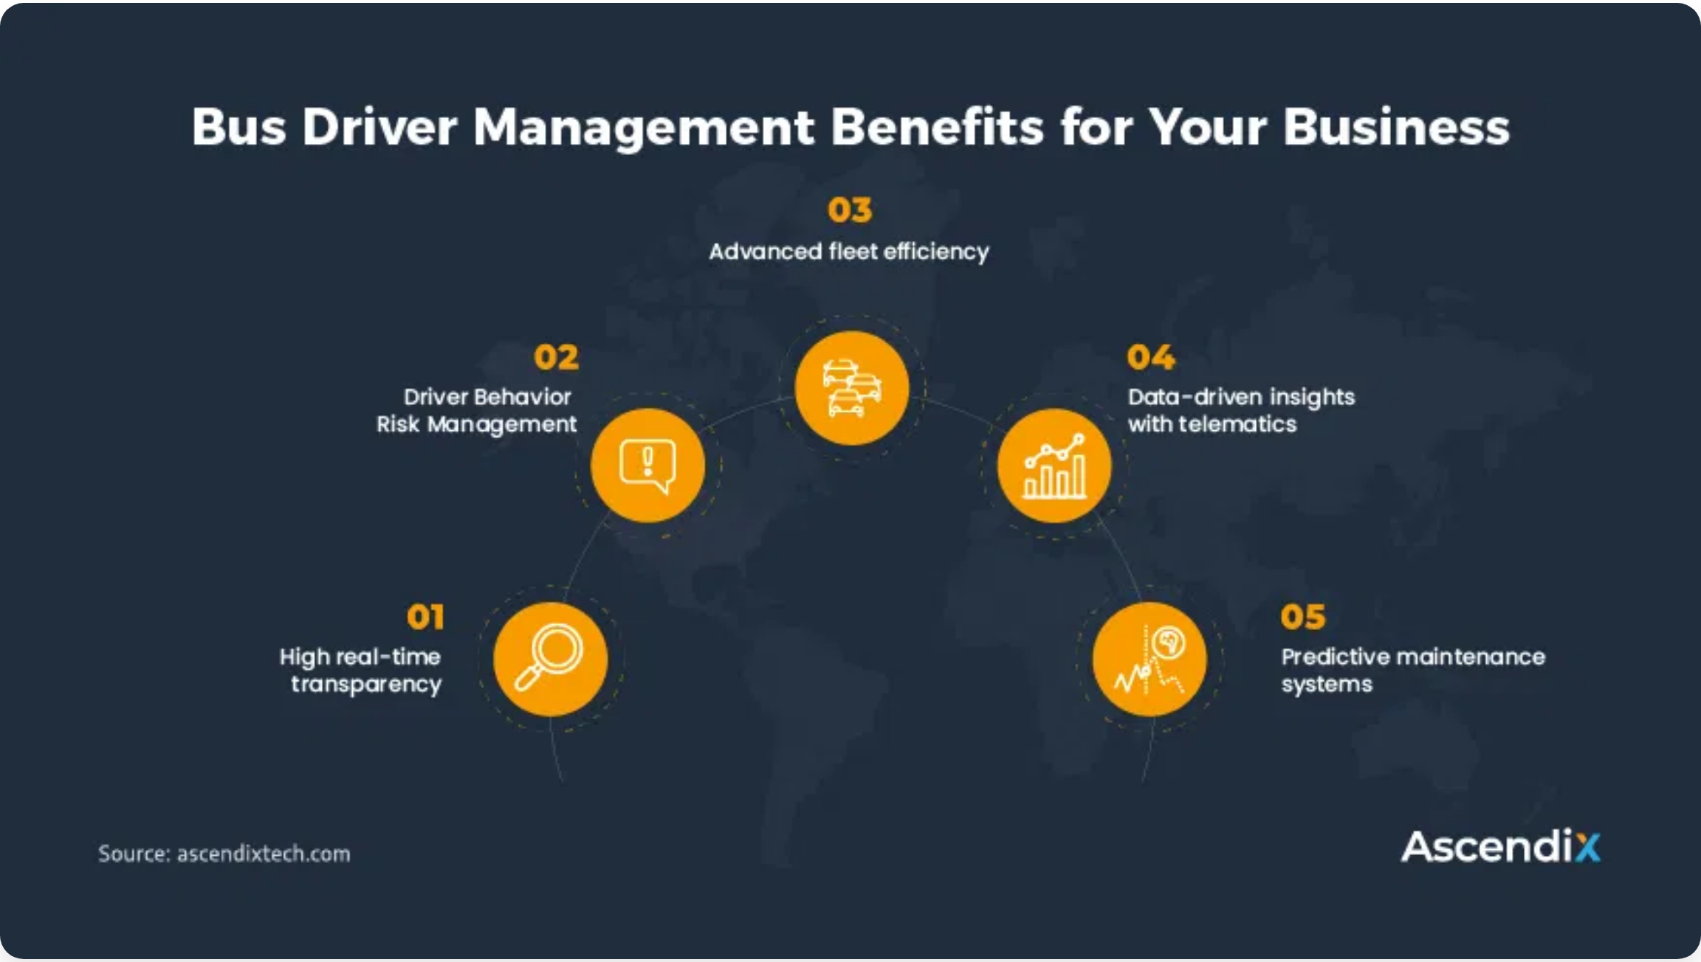

System Overview
Purpose:
Streamline bus ticket booking process for travelers and operators
Target Users:
Travelers, bus operators, travel agencies
Key Benefits:
24/7 availability, real-time seat selection, secure payments
Technology Stack:
React, Spring Boot, MySQL
70%
45%
24/7
Increase in online bookings
Reduction in booking time
Service availability

Slide 3
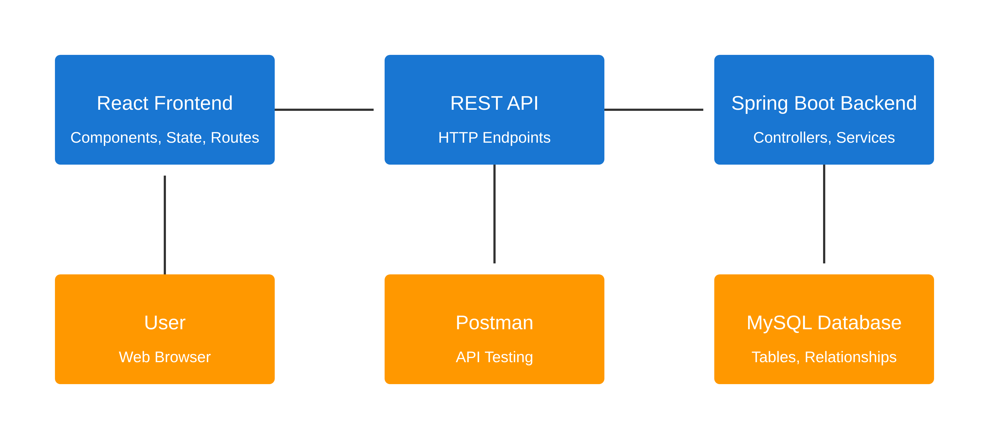



System Architecture
Frontend
Backend
Database
React components & UI
Spring Boot REST API
MySQL relational DB
State management
Business logic layer
JPA data access

Slide 4
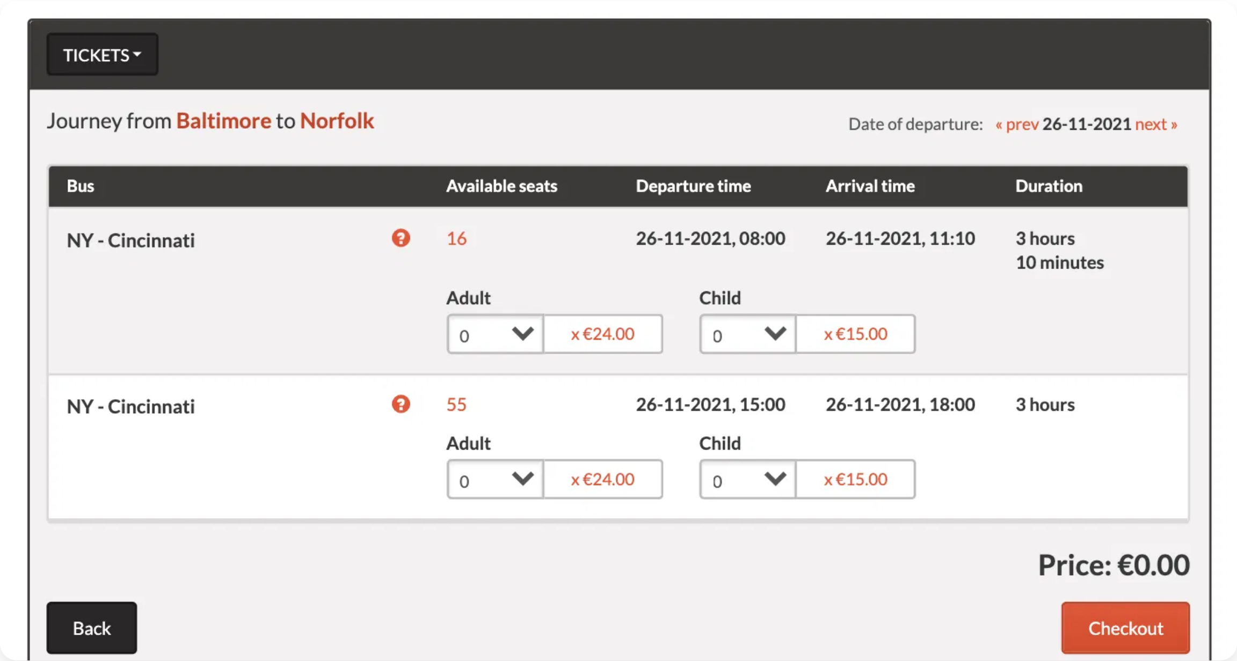








Frontend: React Components
Component Structure
App (Root Component)
Header & Navigation
SearchForm
BusList & BusCard
SeatSelection
BookingForm & Payment
TicketConfirmation
UserDashboard
Footer
Key Libraries
React Router
Redux / Context API
Axios
Formik & Yup
React-Datepicker
Stripe/PaymentJS

Slide 5
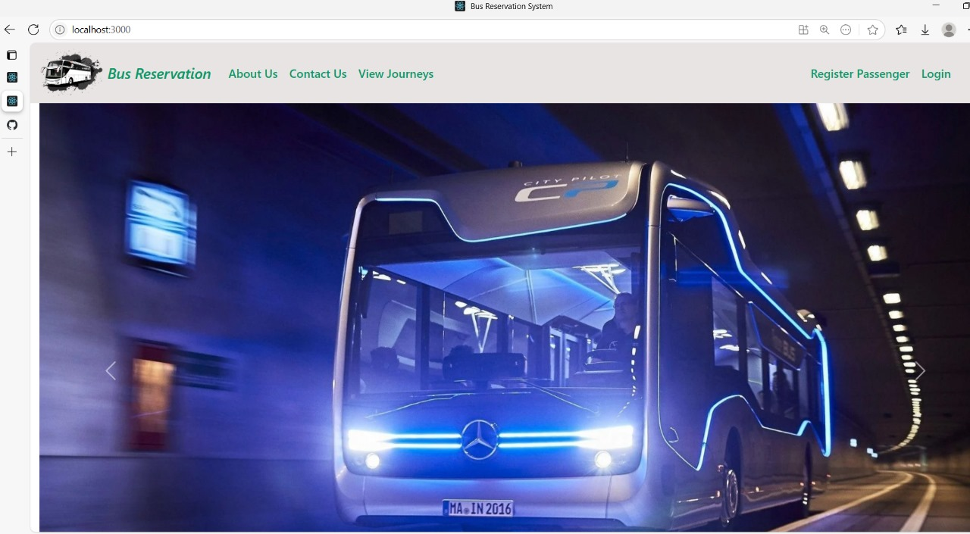
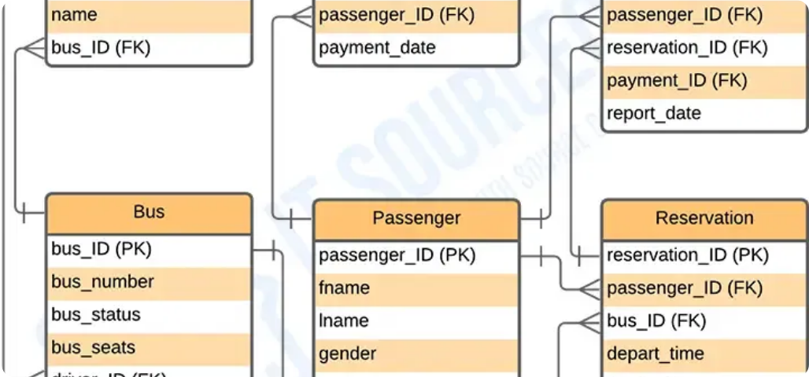




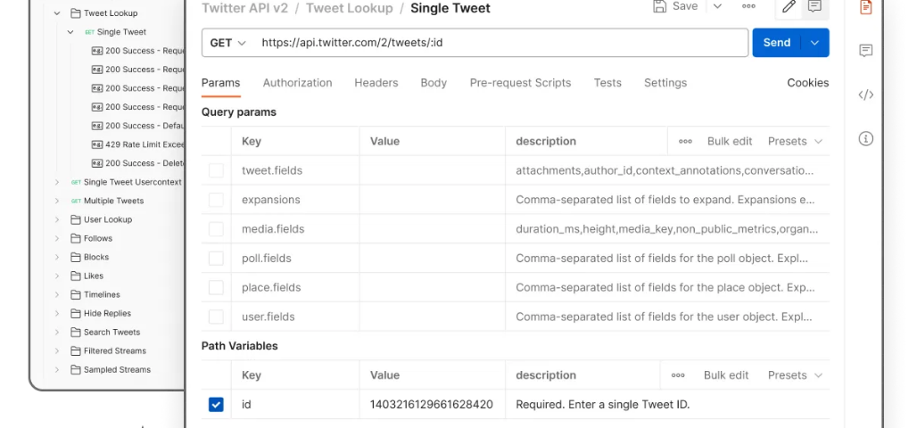
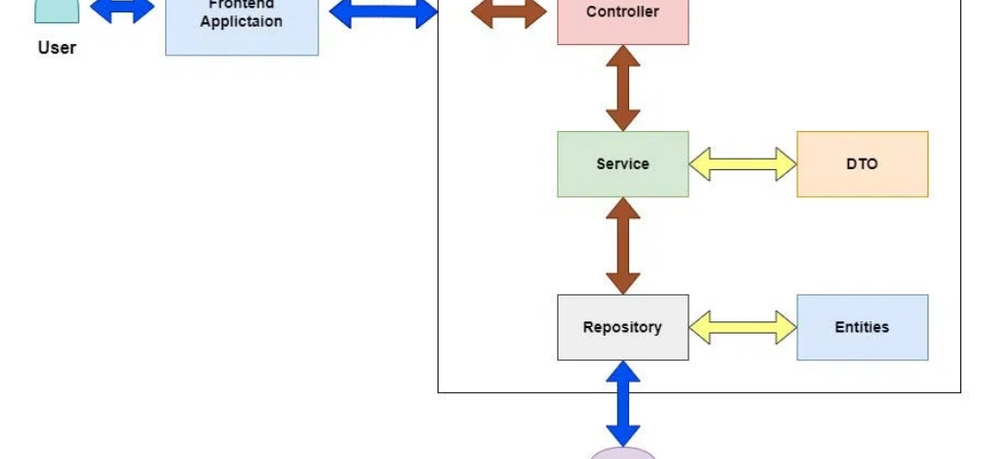
Frontend: UI Design
Key UI Screens
Search Form
Design Principles
Responsive design for all devices
Accessibility compliant (WCAG 2.1)
Bus Listing
Intuitive user flow with minimal steps
Consistent branding and visual language
Color Palette
#1976D2
#FF9800
#4CAF50
#F44336
#333333
Seat Selection
Payment Screen

Slide 6

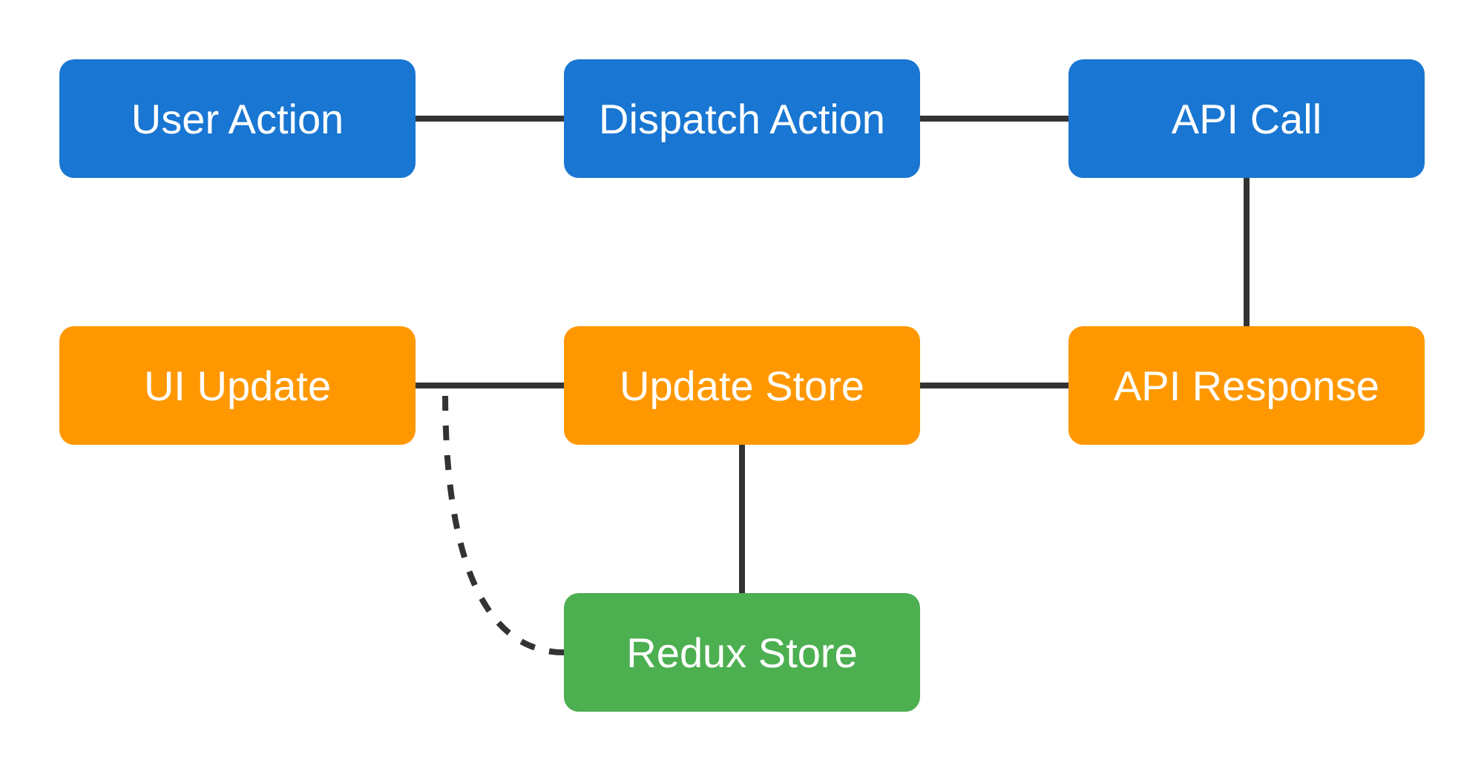






Frontend: State & API Integration
State Management
Data Flow
Redux store for global state
Context API for theme & auth
Local component state for UI
Persistent state with localStorage
API Integration
// API Service using Axios
import axios from 'axios';
const API_URL = 'http://api.busreservation.com';
export const BusService = {
// Get available buses
searchBuses: async (source, destination, date) => {
try {
const response = await axios.get(
`${API_URL}/buses/search`, {
params: { source, destination, date }
}
);
return response.data;
} catch (error) {
console.error('Error fetching buses:', error);
throw error;
}
},
// Get seat availability
getSeatAvailability: async (busId) => {
try {
const response = await axios.get(
`${API_URL}/buses/${busId}/seats`
);
return response.data;
} catch (error) {
console.error('Error fetching seats:', error);
throw error;
}
}
};
Key Benefits
Centralized state management
Secure API communication
Optimized re-rendering

Slide 7

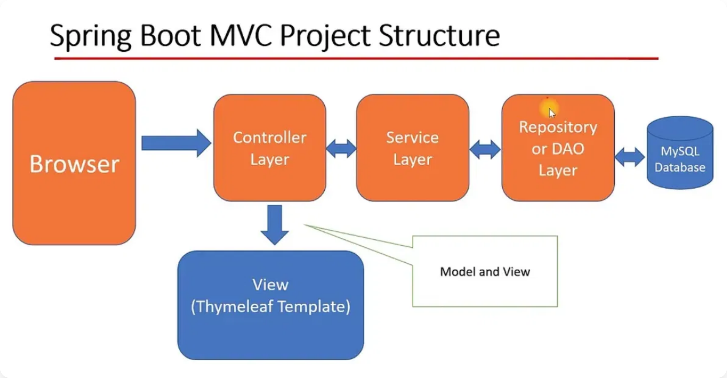







Backend: Spring Boot Architecture
Spring Boot Features
Auto-configuration
Embedded Server
Dependency Injection
Spring Data JPA
Spring Security
Logging & Monitoring
Validation
RESTful APIs
Project Structure
com.busreservation
├── BusReservationApplication.java
├── config/
│ └── SecurityConfig.java
├── controller/
│ ├── BusController.java
│ ├── ReservationController.java
│ └── UserController.java
├── service/
│ ├── BusService.java
│ ├── ReservationService.java
│ └── UserService.java
├── repository/
│ ├── BusRepository.java
│ ├── ReservationRepository.java
│ └── UserRepository.java
├── model/
│ ├── Bus.java
│ ├── Reservation.java
│ └── User.java
└── dto/
├── BusDTO.java
├── ReservationDTO.java
└── UserDTO.java
Key Components
Controllers:
Handle HTTP requests and responses
Services:
Implement business logic and validation
Repositories:
Data access layer using Spring Data JPA
Models/Entities:
Domain objects mapped to database tables
DTOs:
Data Transfer Objects for API communication

Slide 8

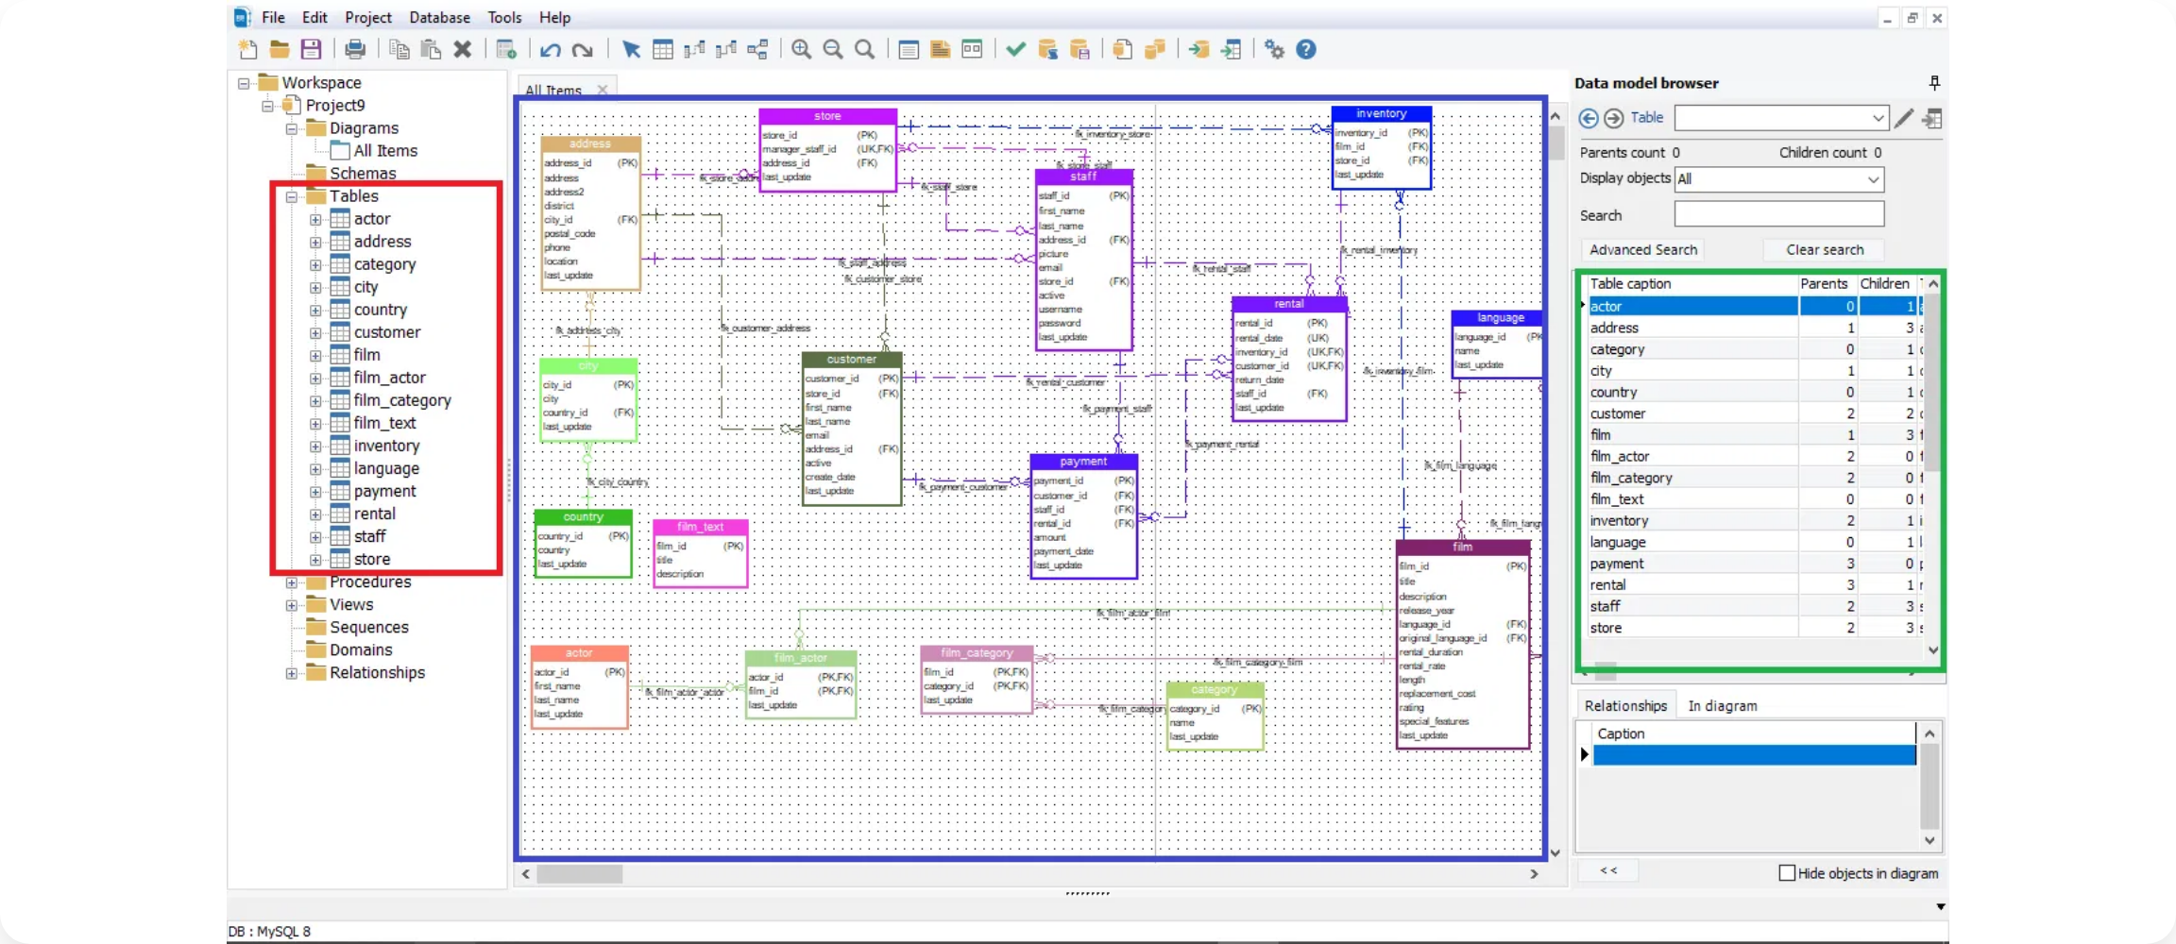




Backend: REST API Endpoints
Controller Implementation
@RestController
@RequestMapping("/api/buses")
public class BusController {
@Autowired
private BusService busService;
@GetMapping
public ResponseEntity
> searchBuses(
@RequestParam String source,
@RequestParam String destination,
@RequestParam @DateTimeFormat(iso = DateTimeFormat.ISO.DATE)
LocalDate date) {
List
Key API Endpoints
API Documentation
Method
Endpoint
Description
Swagger UI:
Interactive API documentation
OpenAPI 3.0:
API specification format
/api/buses
Search available buses
buses = busService.findBuses(
source, destination, date);
return ResponseEntity.ok(buses);
}
@GetMapping("/{id}/seats")
public ResponseEntity
GET
JSON/XML:
Response format options
GET
/api/buses/{id}
Get bus details
JWT Authentication:
Secure API access
GET
/api/buses/{id}/seats
Get seat availability
POST
/api/reservations
Create reservation
getSeatAvailability(
@PathVariable Long id) {
SeatAvailabilityDTO availability =
busService.getSeatAvailability(id);
return ResponseEntity.ok(availability);
}
}
GET
/api/reservations/{id}
Get reservation details
PUT
/api/reservations/{id}
Update reservation
DELETE
/api/reservations/{id}
Cancel reservation

Slide 9










Backend: Business Logic
Reservation Service Implementation
Service Layer Implementation
The service layer contains the core business logic, implementing operations like bus search, seat availability checking, and reservation processing.
@Service
public class ReservationServiceImpl implements ReservationService {
@Autowired
private ReservationRepository reservationRepository;
@Autowired
private BusRepository busRepository;
@Autowired
private SeatRepository seatRepository;
@Override
@Transactional
public ReservationDTO createReservation(ReservationRequest request) {
// Validate bus exists
Bus bus = busRepository.findById(request.getBusId())
.orElseThrow(() -> new ResourceNotFoundException(
"Bus not found with id: " + request.getBusId()));
// Check seat availability
List
Validation Logic
Input validation using Bean Validation (JSR 380)
Business rule validation (e.g., seat availability)
Cross-field validation for complex rules
Custom validators for domain-specific rules
Transaction Management
Error Handling
Spring's declarative transaction management ensures data consistency across multiple operations. The
@Transactional
annotation provides:
Atomic operations (all or nothing)
@ControllerAdvice
public class GlobalExceptionHandler {
@ExceptionHandler(ResourceNotFoundException.class)
public ResponseEntity
Automatic rollback on exceptions
Isolation level control
seats = seatRepository.findByBusIdAndSeatNumberIn(
request.getBusId(), request.getSeatNumbers());
for (Seat seat : seats) {
if (!seat.isAvailable()) {
throw new SeatNotAvailableException(
"Seat " + seat.getSeatNumber() + " is not available");
}
}
// Calculate fare
BigDecimal totalFare = calculateTotalFare(bus, seats.size());
// Create reservation
Reservation reservation = new Reservation();
reservation.setBus(bus);
reservation.setUser(getCurrentUser());
reservation.setSeatNumbers(String.join(",", request.getSeatNumbers()));
reservation.setTotalFare(totalFare);
reservation.setStatus("CONFIRMED");
reservation.setBookingDate(LocalDateTime.now());
// Save reservation
Reservation savedReservation = reservationRepository.save(reservation);
// Update seat availability
updateSeatAvailability(seats, false);
// Return DTO
return mapToDTO(savedReservation);
}
private BigDecimal calculateTotalFare(Bus bus, int seatCount) {
// Apply business logic for fare calculation
// ...
}
}
handleResourceNotFound(
ResourceNotFoundException ex) {
ErrorResponse error = new ErrorResponse(
HttpStatus.NOT_FOUND.value(),
ex.getMessage(),
LocalDateTime.now()
);
return new ResponseEntity<>(error, HttpStatus.NOT_FOUND);
}
@ExceptionHandler(SeatNotAvailableException.class)
public ResponseEntity
handleSeatNotAvailable(
SeatNotAvailableException ex) {
ErrorResponse error = new ErrorResponse(
HttpStatus.CONFLICT.value(),
ex.getMessage(),
LocalDateTime.now()
);
return new ResponseEntity<>(error, HttpStatus.CONFLICT);
}
@ExceptionHandler(MethodArgumentNotValidException.class)
public ResponseEntity
handleValidationErrors(
MethodArgumentNotValidException ex) {
// Handle validation errors
// ...
}
}

Slide 10

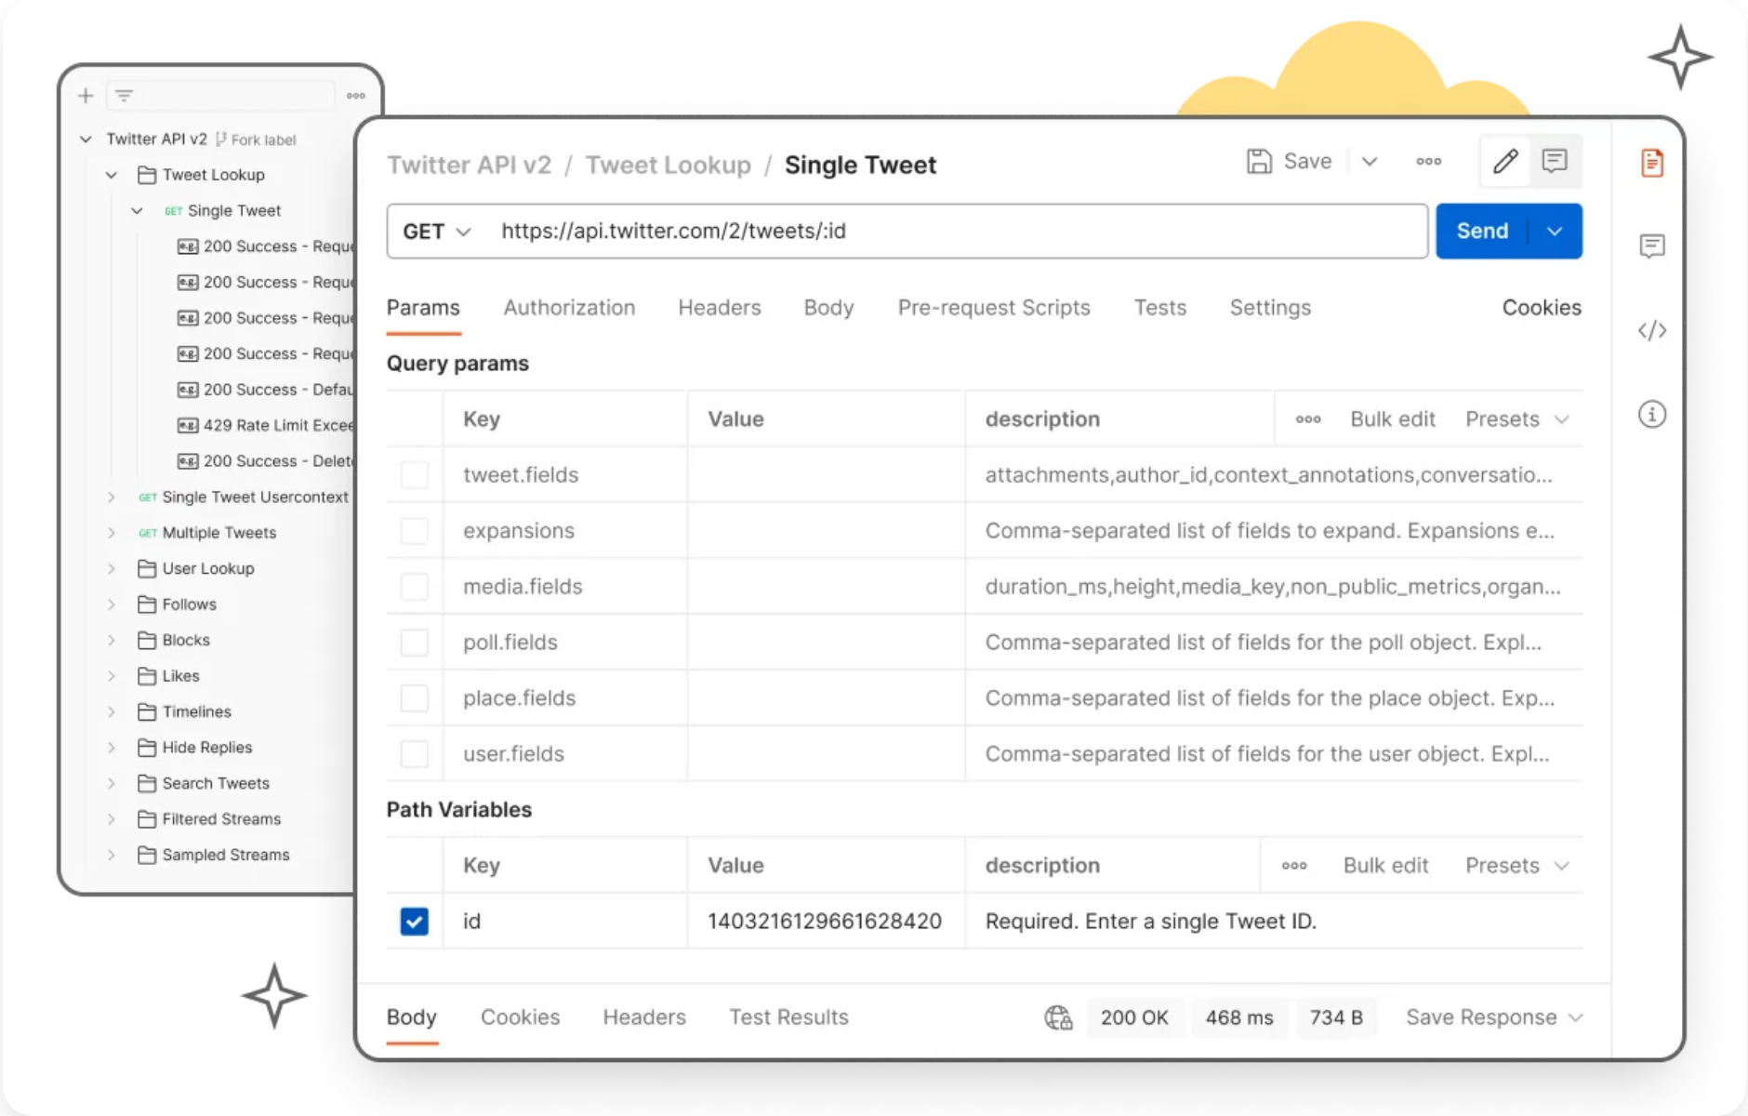






Database: MySQL Schema
Entity Relationship Diagram
Users
Buses
Reservations
user_id
INT PK
bus_id
INT PK
reservation_id
INT PK
username VARCHAR(50)
bus_number VARCHAR(20)
user_id
INT FK
email VARCHAR(100)
total_seats INT
bus_id
INT FK
password VARCHAR(255)
bus_type VARCHAR(50)
seat_numbers VARCHAR(100)
phone VARCHAR(15)
route_id
INT FK
total_fare DECIMAL(10,2)
created_at TIMESTAMP
departure_time DATETIME
status VARCHAR(20)
arrival_time DATETIME
booking_date TIMESTAMP
fare DECIMAL(10,2)
Routes
Seats
Payments
route_id
INT PK
seat_id
INT PK
payment_id
INT PK
source VARCHAR(100)
bus_id
INT FK
reservation_id
INT FK
destination VARCHAR(100)
seat_number VARCHAR(10)
amount DECIMAL(10,2)
distance DECIMAL(10,2)
is_available BOOLEAN
payment_method VARCHAR(50)
duration INT
seat_type VARCHAR(20)
transaction_id VARCHAR(100)
payment_date TIMESTAMP

Slide 11

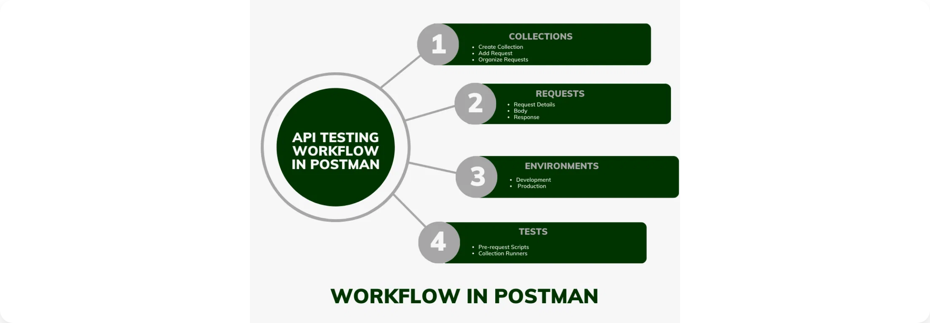







Database: Data Access Layer
Repository Interfaces
public interface BusRepository
extends JpaRepository
{
// Find buses by source, destination and date
@Query("SELECT b FROM Bus b JOIN b.route r " +
"WHERE r.source = :source " +
"AND r.destination = :destination " +
"AND DATE(b.departureTime) = :date")
List
Spring Data JPA
findBySourceAndDestinationAndDate(
@Param("source") String source,
@Param("destination") String destination,
@Param("date") LocalDate date);
// Find buses with available seats
@Query("SELECT b FROM Bus b WHERE b.id IN " +
"(SELECT s.bus.id FROM Seat s " +
"WHERE s.isAvailable = true " +
"GROUP BY s.bus.id " +
"HAVING COUNT(s) >= :seatCount)")
List
Repository interfaces
with auto-implemented CRUD operations
Common Database Operations
Method name queries
for automatic query generation
CRUD operations:
save(), findById(), findAll(), delete()
@Query annotation
for custom JPQL or native SQL
Filtering:
findBySourceAndDestination(), findByDepartureDateBetween()
Specification API
for dynamic query building
Entity Mapping
Sorting:
findAllByOrderByDepartureTimeAsc(), findBySourceOrderByFareAsc()
findBusesWithAvailableSeats(
@Param("seatCount") Integer seatCount);
// Find by bus number
Optional
@Entity
@Table(name = "buses")
public class Bus {
@Id
@GeneratedValue(strategy = GenerationType.IDENTITY)
private Long id;
@Column(name = "bus_number", nullable = false, unique = true)
private String busNumber;
@Column(name = "total_seats")
private Integer totalSeats;
@Column(name = "bus_type")
private String busType;
@ManyToOne(fetch = FetchType.LAZY)
@JoinColumn(name = "route_id")
private Route route;
@Column(name = "departure_time")
private LocalDateTime departureTime;
@Column(name = "arrival_time")
private LocalDateTime arrivalTime;
@Column(name = "fare")
private BigDecimal fare;
@OneToMany(mappedBy = "bus", cascade = CascadeType.ALL)
private List
Pagination:
findAll(Pageable), findByBusType(String, Pageable)
findByBusNumber(String busNumber);
}
seats;
// Getters and setters
}

Slide 12

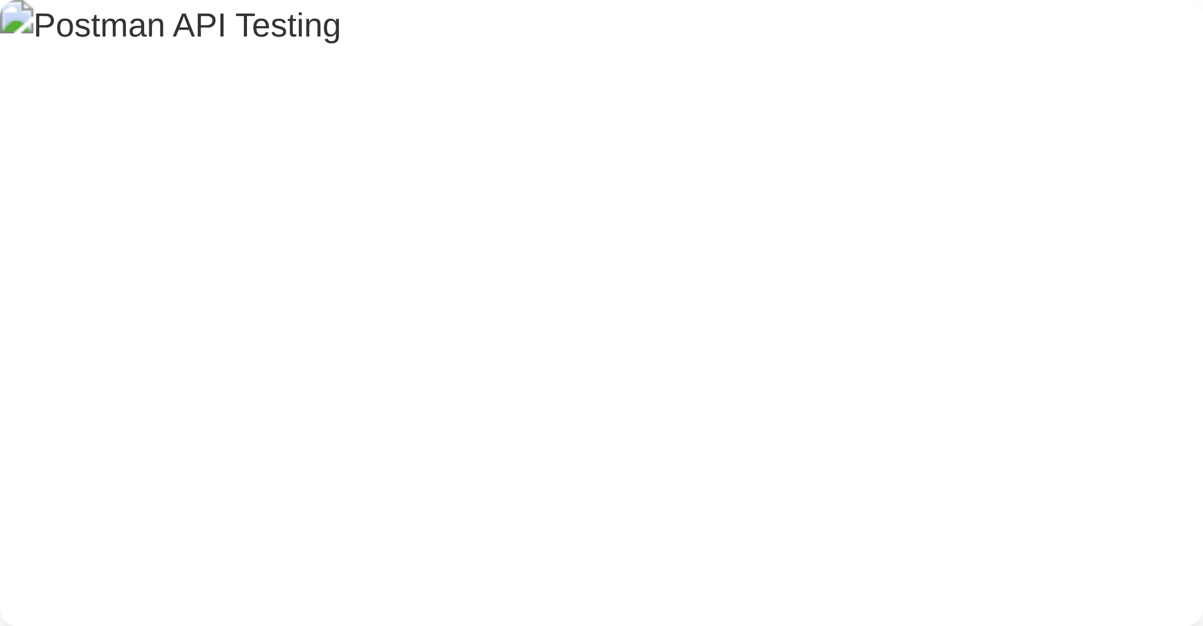









Testing: API with Postman
Test Script Example
// Test for successful bus search
pm.test("Status code is 200", function() {
pm.response.to.have.status(200);
});
pm.test("Response time is less than 500ms", function() {
pm.expect(pm.response.responseTime).to.be.below(500);
});
pm.test("Response has buses array", function() {
var jsonData = pm.response.json();
pm.expect(jsonData).to.be.an('array');
pm.expect(jsonData.length).to.be.at.least(1);
});
pm.test("Bus data structure is valid", function() {
var jsonData = pm.response.json();
var bus = jsonData[0];
pm.expect(bus).to.have.property('id');
pm.expect(bus).to.have.property('busNumber');
pm.expect(bus).to.have.property('departureTime');
pm.expect(bus).to.have.property('arrivalTime');
pm.expect(bus).to.have.property('fare');
});
Postman Features
Collections:
Organize API requests by functionality
Environments:
Configure variables for different setups (dev, test, prod)
Pre-request scripts:
Execute code before request is sent
Test scripts:
Validate responses with assertions
Testing Workflow
API Test Coverage:
CRUD operations for all entities
Test Scenarios:
Happy paths, edge cases, error handling
Automation:
Run collections via Newman for CI/CD integration
Documentation:
Auto-generate API docs from collections

Slide 13














System Features
Bus Search
Seat Selection
Advanced search functionality to find available buses based on source, destination, and date.
Interactive seat layout allowing users to select their preferred seats from available options.
Filter by time, bus type, and price
Visual seat map with status indicators
Real-time availability updates
Multiple seat selection capability
Secure Payment
E-Tickets
Multiple payment options with secure transaction processing and instant confirmation.
Paperless ticketing system with digital tickets delivered via email and available in the user account.
Credit/debit cards, digital wallets
QR code for easy boarding
PCI-DSS compliant payment gateway
Downloadable PDF tickets
User Profiles
Notifications
Personalized user accounts to manage bookings, view history, and store preferences.
Automated alerts and notifications for booking confirmations, reminders, and travel updates.
Booking history and upcoming trips
Email and SMS notifications
Saved passenger details for quick booking
Trip reminders and schedule changes

Slide 14
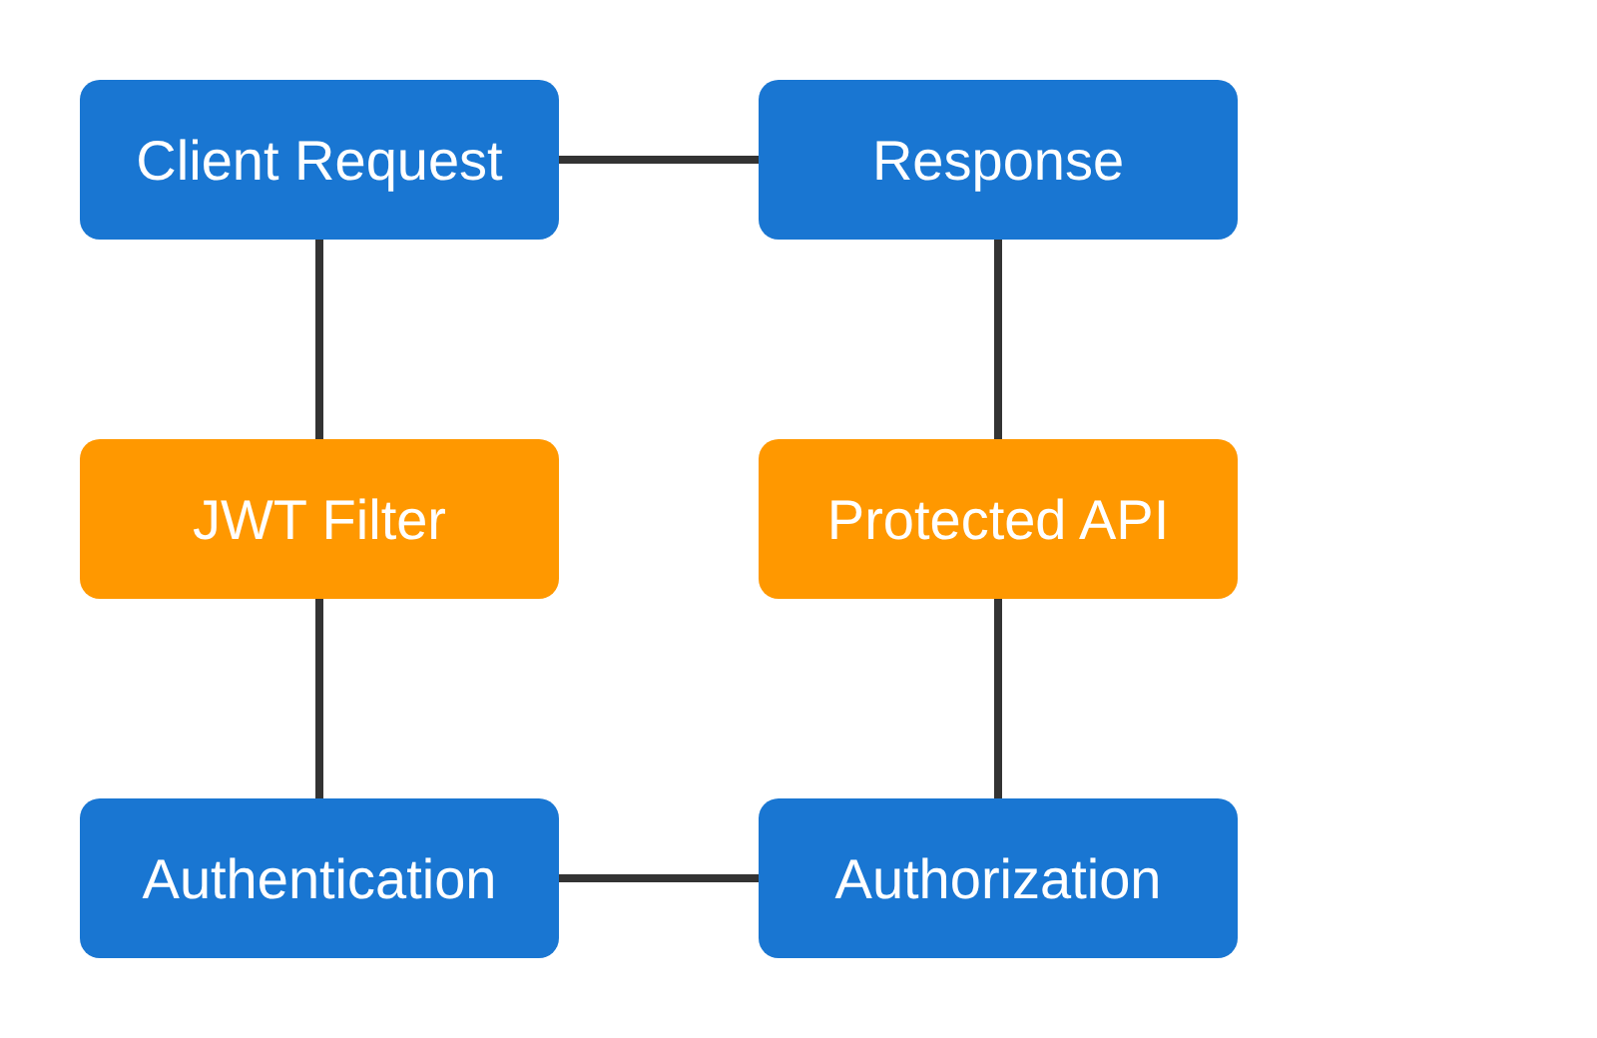








Security Implementation
Spring Security Configuration
@Configuration
@EnableWebSecurity
public class SecurityConfig extends WebSecurityConfigurerAdapter {
@Autowired
private JwtAuthenticationFilter jwtAuthFilter;
@Autowired
private UserDetailsService userDetailsService;
@Override
protected void configure(HttpSecurity http) throws Exception {
http
.csrf().disable()
.authorizeRequests()
.antMatchers("/api/auth/**").permitAll()
.antMatchers("/api/buses/**").permitAll()
.antMatchers("/api/reservations/**").authenticated()
.antMatchers("/api/admin/**").hasRole("ADMIN")
.anyRequest().authenticated()
.and()
.sessionManagement()
.sessionCreationPolicy(SessionCreationPolicy.STATELESS)
.and()
.addFilterBefore(jwtAuthFilter,
UsernamePasswordAuthenticationFilter.class);
}
@Bean
public PasswordEncoder passwordEncoder() {
return new BCryptPasswordEncoder();
}
}
Data Protection
Authentication & Authorization
HTTPS/TLS encryption
for data in transit
Sensitive data encryption
in database
JWT-based authentication
for stateless API security
Input validation
to prevent injection attacks
Role-based access control
(RBAC) for authorization
PCI DSS compliance
for payment processing
Password encryption
using BCrypt hashing algorithm
Token expiration
and refresh token mechanism

Slide 15
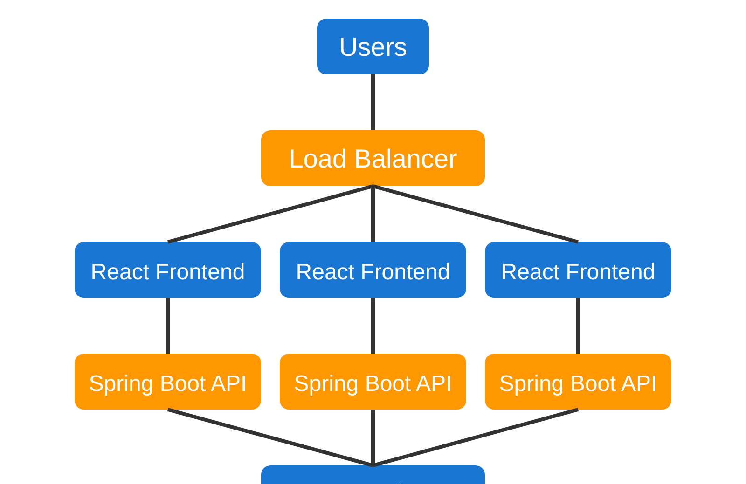












Deployment Strategy
CI/CD Pipeline
Code
Test
Build
Verify
Deploy
Git repository with branch protection
Unit & integration tests
Docker images & artifacts
Quality gates & security scans
Automated deployment
Monitoring & Maintenance
Infrastructure
Performance Monitoring:
Prometheus & Grafana dashboards
Cloud Platform:
AWS/Azure for scalability and reliability
Centralized Logging:
ELK stack (Elasticsearch, Logstash, Kibana)
Containerization:
Docker for consistent environments
Alerting:
Automated alerts for system issues
Backup Strategy:
Orchestration:
Kubernetes for container management
Regular database backups with point-in-time recovery
Load Balancing:
Elastic Load Balancer for traffic distribution

Slide 16





Conclusion
System Summary
Future Enhancements
Modern online bus reservation system with React frontend and Spring Boot backend
Mobile applications for iOS and Android platforms
Integration with GPS for real-time bus tracking
Comprehensive features including search, booking, payment, and e-tickets
AI-powered recommendations and dynamic pricing
Secure, scalable architecture with robust data management
Multi-language support and international payment options
User-friendly interface with responsive design for all devices
Key Benefits
Increased customer satisfaction and booking efficiency
Reduced operational costs and administrative overhead
Book Your Bus, Anytime, Anywhere
www.busbooking.com
info@busbooking.com
+1 (800) BUS-BOOK

